Slide 1
ENHANCING PROFESSIONAL DEVELOPMENT THROUGH NEW MODEL OF MAINTENANCE OF SPECIALIST CERTIFICATION
Feb. 23, 2023

Slide 2
Presentation Objectives
Describe the purpose for transitioning to a maintenance program model.
Provide an overview and describe the process for the new MOSC program.
Provide details specific to the year 10 recertification non-proctored examination.
General tips for submitting your MOSC cycle plan.
Detail implications for not meeting MOSC cycle requirements.
Emeritus designation option.

Slide 3
MOSC: Purpose
More effectively verify and facilitate continued competence as an advanced practitioner in the specialty area.
Designed to educate and enrich the clinician’s expertise in the specialty practice area
More effectively evaluate professional development and clinical experience.
Better encourage ongoing education and professional growth.
Keep pace with the rapidly expanding specialty knowledge base and scientific evidence that guides clinical decision-making.
Promote improved health outcomes related to physical therapy specialty services.

Slide 4
Maintenance of Specialist Certification
Certification Cycle
Year
3
MOSC
6
9
10

Slide 5
Minimum Eligibility Requirements of MOSC
Evidence of Current Unrestricted Licensure as a physical therapist in the United States, the District of Columbia, Puerto Rico or the Virgin Islands.
Direct Patient Care in the Specialty Area
Evidence of 200 hours of direct patient care in the specialty practice within each three (3) year submission period.
For sports specialists only, 33 of 200 hours must be venue coverage hours.
Hours accrued in year 10 applied to the next three-year submission period.
CPR and Acute Management of Injury & Illness Course Requirements for Sports Specialists.

Slide 6
Minimum Eligibility Requirements of MOSC
Commitment to Life-Long Learning through Professional Development
Mimics the information captured in the current PDP (professional services, continuing education coursework, publications, presentations, clinical supervision and consultation, research, clinical instruction, teaching).
Minimum requirements for each three (3) submission period across three (3)designated activity areas.
Minimum of 10 MOSC credits, within 2 of the 3 designated activity categories, in years 3, 6, and 9. By year 9, a specialist must have accrued a minimum of 30 MOSC credits, and demonstrated professional development in each of the 3 designated activity categories.
Credits accrued in year 10 applied to the next three-year submission period.
A web-based submission/tracking system.
Completion of an accredited residency or fellowship program meets all requirements for 1 MOSC cycle!

Slide 7
Minimum Eligibility Requirements of MOSC
Commitment to Life-Long Learning through Professional Development
Category 1
Accrual of 200 Direct Patient Care Hours (beyond the minimum required hours of 200 every 3 years) 1 MOSC credit (maximum of 5 MOSC credits in each 3-year cycle)
Accrual of 200 Clinical Supervision, Mentoring, and Consultation Hours 1 MOSC credit (maximum of 5 MOSC credits in each 3-year cycle) Clinical supervision (entry-level physical therapist students and physical therapist assistant students) Mentoring Residents (credentialed residency program) Peer professionals (formal job role/responsibility)
Professional Services Each worth 1 MOSC credit other than ABPTS item writing (maximum of 5 credits cumulative across subcategories in each 3-year cycle) Subject matter expert Committee/board participation (including ABPTS, specialty councils, and other specialty-related appointments) Task force or work group (ABPTS, APTA section or component-sponsored; or other professional organization) Item writing (1 MOSC for every 5 items accepted by specialty council for board exam for ABPTS specialty certification) Committee content experts (eg, CCE, appointed ABPTS position - must serve full term, unless term could not be completed due to professional advancement in another ABPTS position) Administrative activities Starting a residency or fellowship program Community service in clinical specialty area

Slide 8
Minimum Eligibility Requirements of MOSC
Category 2
Completion of a CE Course 1 MOSC credit for every 10 contact hours (specialty-related CEU)
Completion of a CE Course/Residency/Fellowship Successful completion of an APTA-accredited residency or fellowship program in a designated specialty practice area meets all requirements for one 3-year MOSC cycle.
Completion of College or University Course 5 MOSC credits
Teaching a College or University Course (may count each course only once in each 3-year cycle) Serving as primary instructor/coordinator – 5 MOSC credits Serving as assistant for the course – 2 MOSC credits
Teaching a CE Course (may count each course only once in each 3-year cycle) 2 MOSC credits for every hour of teaching (maximum of 5 MOSC credits in each 3-year cycle)
Notes:
Recommendations:
1. Demonstration of a certified specialist’s commitment to life-long learning should mimic the information captured in the current PDP.
2. The PDP current point system should not be continued in the new model.
3. Recommend increased flexibility and more direct examples of what would be acceptable while maintaining the current categories for research and practice.
a. Acceptable activities would need to go beyond simple attendance at continuing education workshops. Activities should include: continuing education coursework, publications, presentations, clinical instruction, or teaching.
4. An individual must demonstrate how their participation in the various activities contributed in some way to the profession.
5. Documentation of activities should be submitted on an annual basis, covering multiple activities. However, if special circumstances arise for candidates that prohibit an annual submission, it should be taken this into consideration and a extension or waiver for the year would be appropriately granted.
6. Staff will put together a proposed schedule, including activity areas to be covered by certified specialists, based on the current activity listings in specialty PDP summary worksheets.
7. Staff will continue to work with APTA’s IT Department to determine how best to secure a web-based system to track continuing competence in a specialty area.
i. The web-based system should provide an individual account tracking
mechanism for each specialist to record professional development activities during years 1-7 of their certification cycle.
ii. System should be a component of APTA’s Learning Center. However, the
development of this module within the Learning Center is currently on hold. Staff will continue to communicate with APTA’s Professional Development Committee to assure we are kept up-to-date on current timelines and developments.
8. There is NOT an hour requirement in this area but the specialist must show evidence of
professional development activities with, at minimum, annual documentation of
professional development activities. These activities include continuing education
coursework, publications, presentations, clinical instruction, or teaching.

Slide 9
Minimum Eligibility Requirements of MOSC
Category 3
Professional Presentations (Maximum of 5 credits cumulative across subcategories in each 3-year cycle.) Peer-reviewed presentations (each worth 2 MOSC credits): - platform or poster presentation - invited speaker Non-peer reviewed presentations (each worth 1 MOSC credit): - in-service presentations - presentation to professional groups - presentation to client-based groups - presentation to community groups - panelist at forum - Participation in a journal club - Other
Research Activities Each worth 1 MOSC credit (maximum of 5 credits cumulative across subcategories in each 3-year cycle) Contributions to PT Outcomes Database Contributions to PT research project Participation in an ABPTS revalidation study Research Summit participation Other
Notes:
Recommendations:
1. Demonstration of a certified specialist’s commitment to life-long learning should mimic the information captured in the current PDP.
2. The PDP current point system should not be continued in the new model.
3. Recommend increased flexibility and more direct examples of what would be acceptable while maintaining the current categories for research and practice.
a. Acceptable activities would need to go beyond simple attendance at continuing education workshops. Activities should include: continuing education coursework, publications, presentations, clinical instruction, or teaching.
4. An individual must demonstrate how their participation in the various activities contributed in some way to the profession.
5. Documentation of activities should be submitted on an annual basis, covering multiple activities. However, if special circumstances arise for candidates that prohibit an annual submission, it should be taken this into consideration and a extension or waiver for the year would be appropriately granted.
6. Staff will put together a proposed schedule, including activity areas to be covered by certified specialists, based on the current activity listings in specialty PDP summary worksheets.
7. Staff will continue to work with APTA’s IT Department to determine how best to secure a web-based system to track continuing competence in a specialty area.
i. The web-based system should provide an individual account tracking
mechanism for each specialist to record professional development activities during years 1-7 of their certification cycle.
ii. System should be a component of APTA’s Learning Center. However, the
development of this module within the Learning Center is currently on hold. Staff will continue to communicate with APTA’s Professional Development Committee to assure we are kept up-to-date on current timelines and developments.
8. There is NOT an hour requirement in this area but the specialist must show evidence of
professional development activities with, at minimum, annual documentation of
professional development activities. These activities include continuing education
coursework, publications, presentations, clinical instruction, or teaching.

Slide 10
Minimum Eligibility Requirements of MOSC
Category 3
Professional Writing (Authorship/ Editorship) (maximum of 5 credits cumulative across subcategories in each 3- year cycle) Peer-Reviewed Writing (each worth 3 MOSC credits): - Book chapter - Peer-reviewed journal article - Editor (journal, book) - Grant proposal, primary investigator or co-investigator (funded/unfunded) - Case study or case report - Home-study module - Other Non-Peer Reviewed Writing (each worth 1 MOSC credit): - Non-peer reviewed article/publication - Reviews or commentaries - Manuscript reviewer - Abstract reviewer for professional conference - Hooked on evidence - Other
Notes:
Recommendations:
1. Demonstration of a certified specialist’s commitment to life-long learning should mimic the information captured in the current PDP.
2. The PDP current point system should not be continued in the new model.
3. Recommend increased flexibility and more direct examples of what would be acceptable while maintaining the current categories for research and practice.
a. Acceptable activities would need to go beyond simple attendance at continuing education workshops. Activities should include: continuing education coursework, publications, presentations, clinical instruction, or teaching.
4. An individual must demonstrate how their participation in the various activities contributed in some way to the profession.
5. Documentation of activities should be submitted on an annual basis, covering multiple activities. However, if special circumstances arise for candidates that prohibit an annual submission, it should be taken this into consideration and a extension or waiver for the year would be appropriately granted.
6. Staff will put together a proposed schedule, including activity areas to be covered by certified specialists, based on the current activity listings in specialty PDP summary worksheets.
7. Staff will continue to work with APTA’s IT Department to determine how best to secure a web-based system to track continuing competence in a specialty area.
i. The web-based system should provide an individual account tracking
mechanism for each specialist to record professional development activities during years 1-7 of their certification cycle.
ii. System should be a component of APTA’s Learning Center. However, the
development of this module within the Learning Center is currently on hold. Staff will continue to communicate with APTA’s Professional Development Committee to assure we are kept up-to-date on current timelines and developments.
8. There is NOT an hour requirement in this area but the specialist must show evidence of
professional development activities with, at minimum, annual documentation of
professional development activities. These activities include continuing education
coursework, publications, presentations, clinical instruction, or teaching.

Slide 11
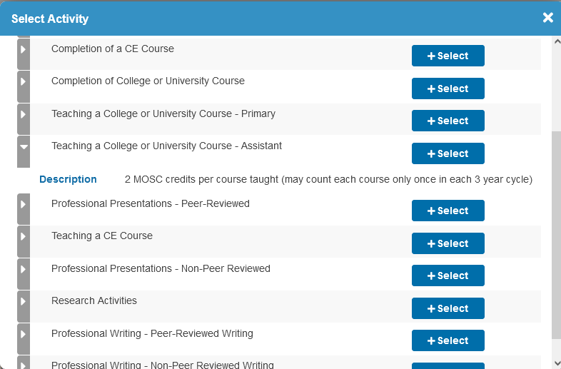
Minimum Eligibility Requirements of MOSC
Commitment to Life-Long Learning through Professional Development
Notes:
3. Recommend increased flexibility and more direct examples of what would be acceptable while maintaining the current categories for research and practice.
a. Acceptable activities would need to go beyond simple attendance at continuing education workshops. Activities should include: continuing education coursework, publications, presentations, clinical instruction, or teaching.
4. An individual must demonstrate how their participation in the various activities contributed in some way to the profession.
5. Documentation of activities should be submitted on an annual basis, covering multiple activities. However, if special circumstances arise for candidates that prohibit an annual submission, it should be taken this into consideration and a extension or waiver for the year would be appropriately granted.
6. Staff will put together a proposed schedule, including activity areas to be covered by certified specialists, based on the current activity listings in specialty PDP summary worksheets.
7. Staff will continue to work with APTA’s IT Department to determine how best to secure a web-based system to track continuing competence in a specialty area.
i. The web-based system should provide an individual account tracking
mechanism for each specialist to record professional development activities during years 1-7 of their certification cycle.
ii. System should be a component of APTA’s Learning Center. However, the
development of this module within the Learning Center is currently on hold. Staff will continue to communicate with APTA’s Professional Development Committee to assure we are kept up-to-date on current timelines and developments.
8. There is NOT an hour requirement in this area but the specialist must show evidence of
professional development activities with, at minimum, annual documentation of
professional development activities. These activities include continuing education
coursework, publications, presentations, clinical instruction, or teaching.

Slide 12
Minimum Eligibility Requirements of MOSC
Practice Performance through Examples of Clinical Care and Clinical Reasoning
Online submission of one (1) Reflective Portfolio for each three (3) year submission period.
Demonstrate the clinical care and reasoning utilized and reflect how a patient case(s) has impacted practice.
Not scored but screened for completion of required information and reflection.
Should be an actual patient case within the current three-year cycle window.
Specialists need only reflect on two sections of the case study.
Optional sample reflective questions are provided for specialists to consider. This is not an exhaustive list and candidate are not responsible for addressing all or any of the samples provided)
There is not a word limit or reference limit.

Slide 13
Minimum Eligibility Requirements of MOSC
Cognitive Expertise through a Test of Knowledge in the Profession.
The goal of the exam, and maintenance program generally, is to facilitate continued competence, and designed to educate and enrich the clinician’s expertise in the specialty practice area.
Each specialty recertification exam blueprint will be consistent to include the following 3 general categories:
Knowledge Areas
Professional Roles, Responsibilities and Values
Patient/Client Management
Successful completion of requirements 1-3 at each three (3) year submission period are pre-requisites for year 10 recertification exam.
Non-proctored examination. Use of external resources and reference materials permitted.
Comprised of approximately 100 multiple choice items.
Required to complete a minimum of 25 questions per session block - within a 2-month period.

Slide 14
Minimum Eligibility Requirements of MOSC
Specialists will be permitted to take the next block of 25 questions immediately after completing a prior block - if they choose. However, the 2-month period dates do not change if an individual happens to start their 2nd, 3rd, or 4th block of items early.
Will be given up to 10 minutes to complete each item on the exam.
The 10-minute clock for each item will not start until the whole item vignette (including any graphics) is displayed to and reviewed by the examinee. There will be no video items included.
Will be granted the opportunity to request that provisions be made to account for “life-events” that might impede an examinee’s ability to complete any portion of the exam cycle in the 10th or 11th years.
A list of references by specialty area with preamble of preparatory intent will be made available online by specialty on the maintenance program website.
Notes:
Demonstrate continued competency in general areas of the profession, such as knowledge areas, professional roles and responsibilities, coordination/communication/ documentation, and patient/client related instruction.

Slide 15
MOSC Year 10 Examination
Cycle 3 Review
July 1st to
August 31
Cycle 4 Review
July 1st to
September 30
25 Questions
May thru June

Slide 16
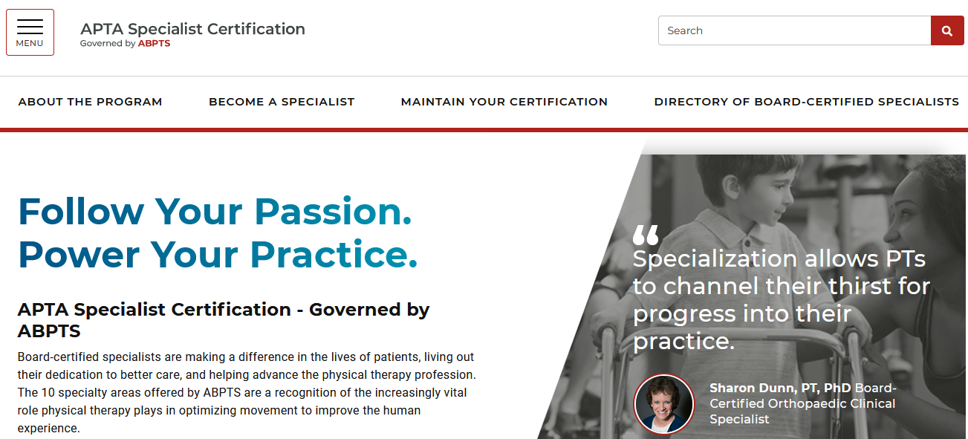
Program Website
https://specialization.apta.org/

Slide 17
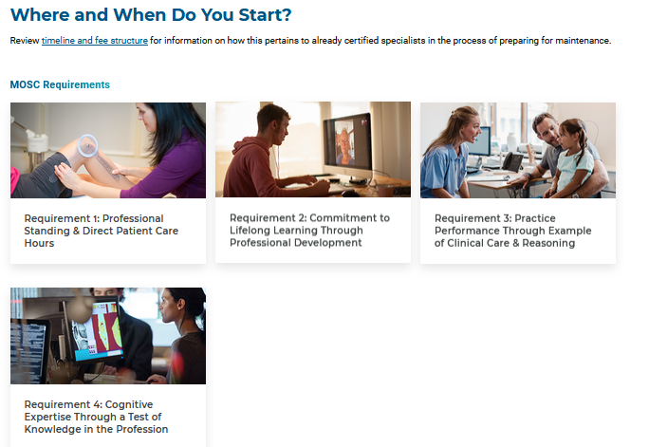
Program Website
http://abptsportal.apta.org/

Slide 18
Submission Portal Login

Slide 19
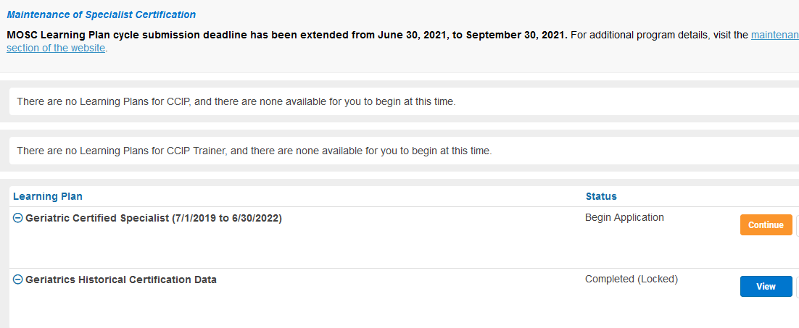
MOSC Learning Plan Submission System
http://abptsportal.apta.org

Slide 20
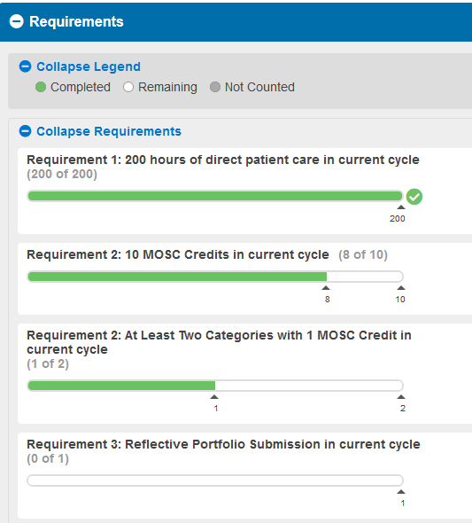
MOSC Learning Plan Submission System
http://abptsportal.apta.org

Slide 21
Tips for MOSC cycle submissions…
Use your APTA ID/email and password to log into the certifications system portal.
If you do not remember your login information, click on “Forgot your password” link or contact APTA's Member Success team at 800-999-2782, or at membersuccess@apta.org.
Do not create a new APTA account; this will not provide you access to your certification record.
All hours and activities submitted must fall within the current three-year cycle timeframe. You may not carry over extra hours or activities to the next cycle learning plan submission.
Activities covering multiple years (e.g., committee service, teaching courses, professional services) should be entered for each year of service.
Direct Patient Care Hour Submissions:
Enter hour submission(s) first as this may secure a good number of points towards the minimum 10 MOSC cycle credit requirement.
If you are a practice owner or are no longer in contact with previous supervisor, self attest.
There is no need to wait for hour approval in order to submit MOSC cycle learning plan.

Slide 22
Tips for MOSC cycle submission…
Support documentation for various activity options are included within submission system and full list of examples posted to maintenance program website.
Successful completion of an APTA-accredited residency or fellowship program, within the designated specialty practice area, meets all requirements for one three-year MOSC cycle if completed during that three-year period.
You may not use this option if already used for your previous initial certification, recertification, or MOSC cycle submission.
For sports specialists, a list of pre-approved course that meet Acute Management of Injury and Illness requirement is located on the maintenance section of the program website (https://specialization.apta.org).
When all requirements have been met, don’t forget to click the orange submit application button at the upper right or lower right-hand side of the screen!

Slide 23
Cost and Implications for Not Meeting MOSC Cycle Requirements
APTA member rate of $220/$400 non-member per submission cycle; nominal examination fee in year 10.
Regardless of compliance with MOSC cycle requirements, certification is still good for a 10-year period.
Specialists who do not meet MOSC requirements, or opt not to participate in MOSC process, will be required to apply for and sit for initial certification examination again. This includes meeting minimum eligibility requirements and associated fees.

Slide 24
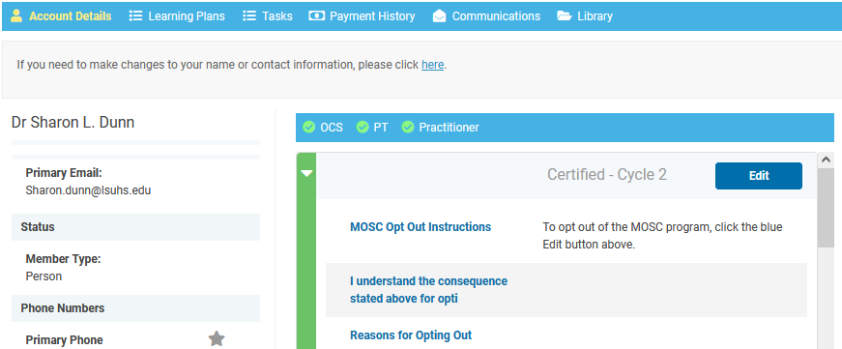
Payment History and Communications

Slide 25
Emeritus Designation Option
Current board-certified specialists who have retired from direct patient/client care (as defined by ABPTS) may apply for the ABPTS “emeritus” designation.
Must meet eligibility requirements and submit emeritus application and $100 application fee through online application portal http://abptsportal.apta.org/ in the last year of an individual’s certification.
Certified specialists with two or more clinical specialties may apply for “emeritus” status only when they have retired from all direct patient and client care, regardless of specialty practice.
May not represent yourself as a board-certified clinical specialist if you resume direct patient/client care.

Slide 26
Emeritus Designation Option
Two exceptions to the requirement of full retirement from direct patient and client care:
a therapist who does not participate in direct care but may perform occasional demonstrations or supervision of patient and client care of with students fewer than five hours in any given week
a therapist who does not participate in direct care but may conduct research or pro bono work where patients and clients are directly influenced or affected by their interaction and can demonstrate an inability to meet the minimum maintenance hour requirement through their research or pro bono work. In either case, or combination of the two, therapists conducting research or pro bono work must not exceed 200 clinical hours in any three-year maintenance cycle.

Slide 27
Questions

Slide 28
For more information contact:
APTA
Specialist Certification Program
3030 Potomac Ave., Suite 100
Alexandria, VA 22305-3085
800/999-2782, ext 3390
Spec-recert@apta.org
https://specialization.apta.org/

